Slide 1
Project Demo-
Digital Chit Fund Management

Slide 2
Agenda
What is Chit Fund?
Problem Statement
Challenges and solutions
Core features
Technology stack
Future enhancements

Slide 3

What is Chit Fund?
Chit funds are a type of savings and credit scheme.

Slide 4
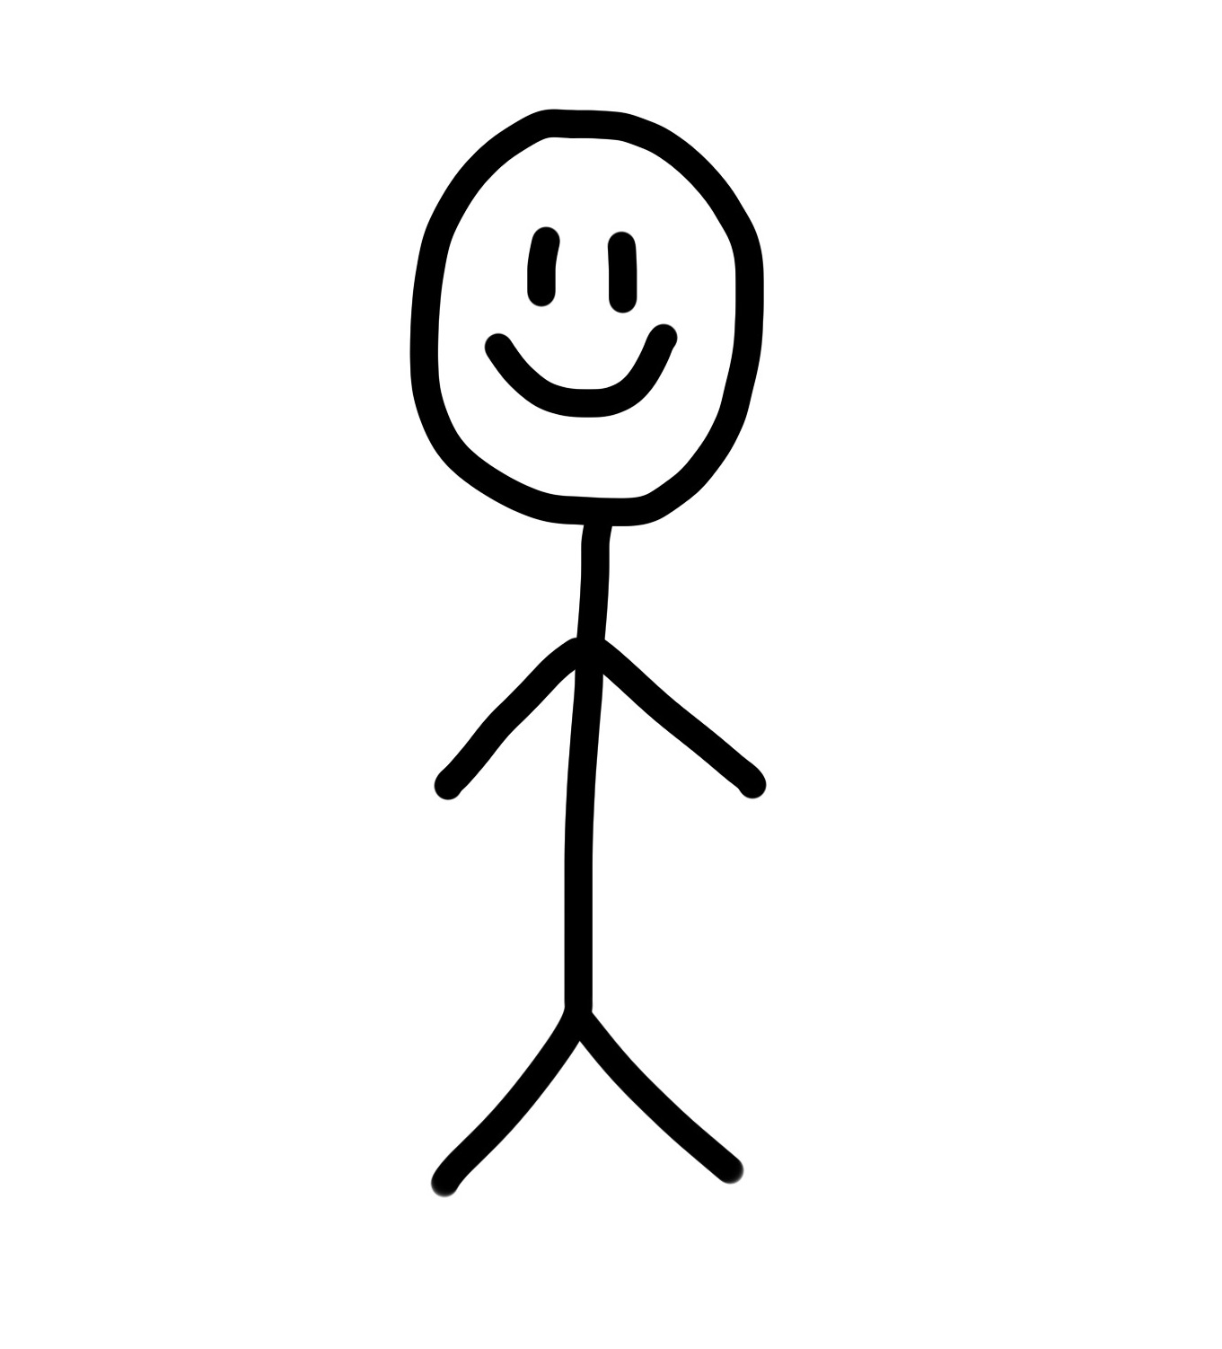
Chit Amount: 50,000
Duration: 5 months
Participants: 5
TicketValue:10,000
ORGANIZER
USERS

Slide 5
ORGANIZER
50,000
10,000
10,000
10,000
10,000
10,000
USERS

Slide 6
10,000
Based on the interest
Commission->2500
10,000
ORGANIZER
Rest is distributed
50,000
40,000
USERS

Slide 7
Problem Statement
Traditional savings schemes in certain communities, like collective savings and borrowing groups, suffer from a lack of transparency and organization. Participants often have little to no visibility into the group’s financial status, and organizers find it hard to manage multiple groups. The community is in need of a secure platform that can automate the management of participants, handle fund allocations, and ensure clear and transparent processes for all involved.

Slide 8
Challenges and Solutions
Participant Management:
Solution: Organizers can manage multiple groups and group participants based on join requests.
Fund Allocations:
Solution: Predefined formula that calculates the amounts.
Transparency:
Solution: View Transactions of a group is available to everyone.

Slide 9
Core Features
Participant Features:
View All available group plans
Request to join a group.
Make payments according to the Ticket Value
View All Group Debit Transactions
Edit Profile
.
Organizer Features:
Create a group
Manage participants- Accept or Reject join group requests
View Montly Plan
View All Group Debit Transactions
View All participants in a group
Edit Profile
.

Slide 10


Technology Stack
Frontend:
React with TypeScript.
Tailwindcss
Backend:
Node.js and Express for REST APIs.
MongoDB for storing data.
JWT for authentication and role-based authorization.

Slide 11
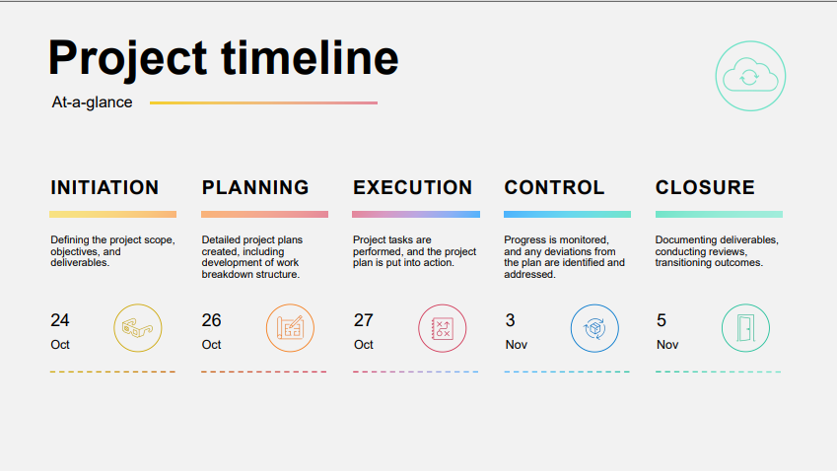

Slide 12
Future Enhancements
Payment gateway integration for secure transactions.
Implementation of notification system.

Slide 13
Thank You

